Slide 1


A Major Project Presentation
On
AQUA FLOW
Department of Bachelor of Computer Application
ITM College of Management GIDA Gorakhpur-273209
Session 2023-24

Slide 2

AQUA FLOW
Project Presentation by:
Shalini
Wajid Ali
Amrita Kumari
Sudhir Kumar
Siddharth Maurya

Slide 3
1. Introduction 2. Abstract 3. Objectives & Scope 4. About Solution 5. Diagram 6. Technology Use 7. Snapshots 8. Conclusion
Presentation Outline

Slide 4
1
INTRODUCTION
In recent years, the circulation of drinking water across India has undergone a transformative shift, propelled by the convergence of technology and commerce. One notable avenue through which this evolution manifests is the utilization of online ordering platforms, such as Google Maps, to facilitate the seamless distribution of safe drinking water to consumers across the vast expanse of the country. This amalgamation of digital connectivity and consumer convenience has revolutionized the accessibility, reliability, and efficiency of obtaining drinking water, transcending geographical barriers and enhancing the overall drinking water infrastructure.
Traditionally, ensuring access to safe drinking water has been a pressing concern in India, given its diverse landscape, varying levels of infrastructure development, and the ever-growing demands of a burgeoning population. the advent of online ordering platforms has emerged as a game-changer, democratizing access to safe drinking water and bridging the gap between supply and demand.
The integration of location-based services, such as Google Maps, further enhances this experience by enabling users to pinpoint nearby suppliers, compare offerings, and place orders with unprecedented ease. This fusion of technology and geospatial intelligence not only simplifies the ordering process but also empowers consumers with greater choice and transparency regarding the products available in their vicinity.
Moreover, the circulation of drinking water through online orders fosters a paradigm shift in the dynamics of supply chain management and logistics. Suppliers and distributors leverage digital platforms to optimize route planning, streamline inventory management, and enhance delivery efficiency, thereby ensuring timely and reliable fulfillment of orders. Real-time tracking features enable consumers to track the progress of their orders in transit, providing them with valuable insights into delivery timelines and enhancing overall satisfaction.

Slide 5
2
ABSTRACT
In a landscape where traditional procurement mechanisms often falter, the emergence of online ordering platforms signifies a paradigm shift towards greater accessibility and efficiency. Leveraging the ubiquitous reach of the internet and the precision of geospatial technology, consumers can now effortlessly locate and procure drinking water from a myriad of suppliers, facilitated by platforms such as Google Maps.
This digital revolution not only transcends geographical barriers but also fosters transparency and choice. Real-time access to product information empowers consumers to make informed decisions, ensuring the quality and reliability of the water they receive. Furthermore, the integration of location-based services optimizes logistical operations, enhancing delivery efficiency and reducing lead times.
Despite these advancements, challenges persist, including infrastructural gaps and digital literacy disparities. Addressing these hurdles is imperative to ensure equitable access to safe drinking water for all segments of society. As India charts its course towards digital empowerment, the convergence of technology and water management holds promise for a more inclusive and sustainable future.
By harnessing the potential of online ordering platforms, stakeholders can navigate India's thirst more effectively, catalyzing a shift towards a water-secure nation where access to safe drinking water is not merely a privilege but a fundamental right for every citizen.

Slide 6
3
Objective & Scope:
The objective of this study is to investigate and analyze the utilization of online ordering platforms for the circulation of drinking water across India, with a particular focus on enhancing accessibility, reliability, and efficiency.
The scope of the study encompasses the following aspects:
Mapping the Landscape: The study aims to map the current landscape of online ordering platforms for drinking water distribution across India. This includes identifying key stakeholders, such as suppliers, distributors, and consumers, as well as understanding the prevailing trends and challenges.
Technological Integration: An in-depth analysis will be conducted to examine the integration of technology, particularly online platforms such as Google Maps, in facilitating the ordering and delivery process. This involves assessing the usability, functionality, and effectiveness of these platforms in enhancing the circulation of drinking water.
Consumer Perspectives: The study seeks to capture consumer perspectives and experiences regarding the use of online ordering platforms for procuring drinking water. This entails exploring factors influencing consumer decision-making, satisfaction levels, and areas for improvement.
Logistical Efficiency: A critical aspect of the study is to evaluate the logistical efficiency of online ordering platforms in the distribution of drinking water. This includes assessing route optimization, inventory management, and delivery timelines to identify opportunities for optimization and streamlining.

Slide 7
4
About Solution:
The challenges and optimizing the circulation of drinking water across India through online ordering platforms, several key solutions can be proposed:
Infrastructure Development: Invest in infrastructure development to ensure reliable access to safe drinking water in both urban and rural areas. This includes improving water treatment facilities, expanding distribution networks, and enhancing storage capacity to meet growing demand.
Digital Literacy Initiatives: Implement digital literacy initiatives to educate consumers, particularly in rural and underserved communities, about the benefits and usage of online ordering platforms. This includes providing training programs, workshops, and awareness campaigns to enhance digital literacy skills.
Partnerships and Collaborations: Foster partnerships and collaborations between government agencies, technology providers, water suppliers, and community organizations to streamline the implementation of online ordering platforms. This includes incentivizing collaborations through public-private partnerships and facilitating knowledge sharing among stakeholders.
User-Centric Design: Develop user-centric design solutions for online ordering platforms to enhance accessibility and usability for diverse user groups. This includes incorporating features such as language localization, intuitive navigation, and accessibility options to cater to the needs of all consumers, including those with disabilities.
Quality Assurance Mechanisms: Implement stringent quality assurance mechanisms to ensure the safety and reliability of drinking water distributed through online ordering platforms. This includes regular monitoring, testing, and certification of water sources, packaging materials, and delivery processes to uphold quality standards.
Incentive Programs: Introduce incentive programs to encourage the adoption of online ordering platforms among consumers and suppliers. This includes offering discounts, rewards, and loyalty programs to incentivize usage and promote customer retention.
Regulatory Framework: Develop a robust regulatory framework to govern the operation of online ordering platforms for drinking water distribution.

Slide 8
5
Diagram:
Registration
Landing Page
Modules:
Admin
Buyer
Seller
Supplier
New User
Vender
Dashboard
Vender Dashboard
Registered
User
Login Portal
Vender Login
Order Portal
Change Status

Slide 9



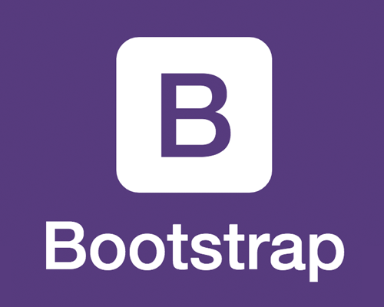
6
Technology Use
FRONTEND
HTML
CSS
BOOTSTRAP
JAVASCRIPT
BACKEND
LARAVEL
MYSQL
PHP Framework

Slide 10
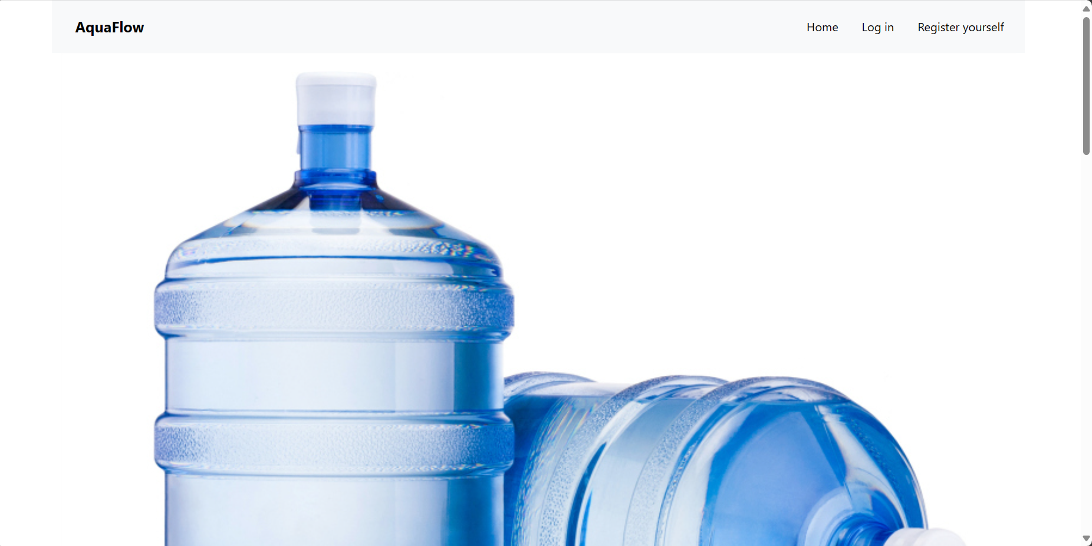
7
Snapshots:
Successful Testing
Home Page

Slide 11
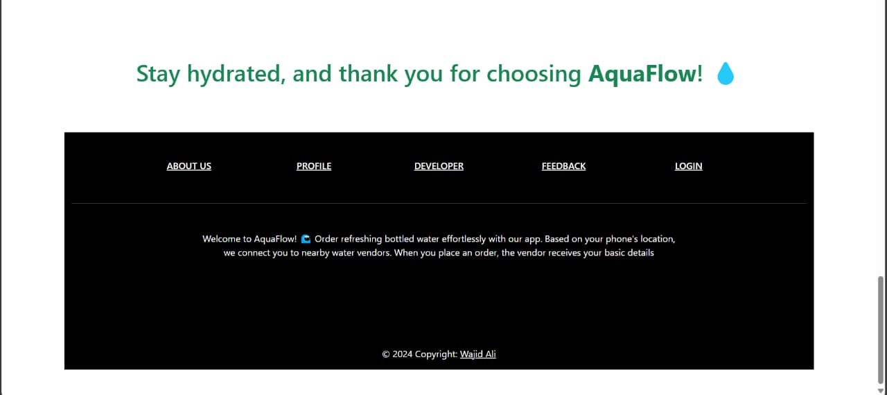
Snapshots:
Successful Testing
Footer Page

Slide 12
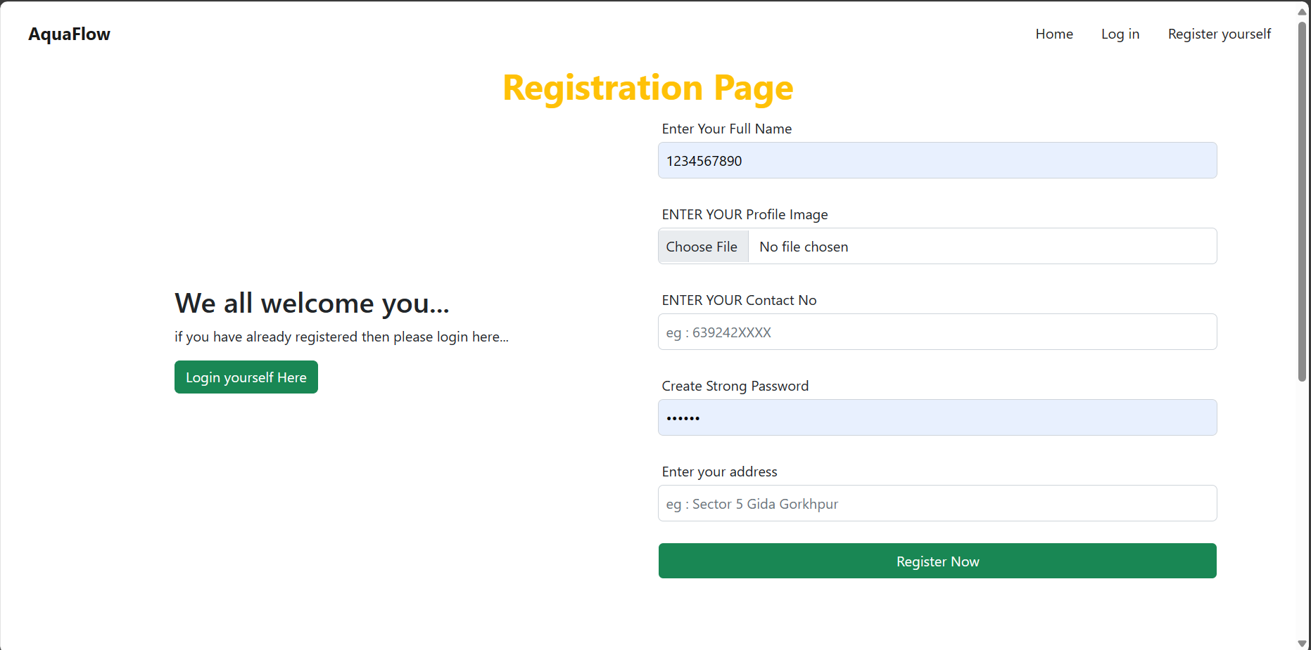
Snapshots:
Successful Testing

Slide 13
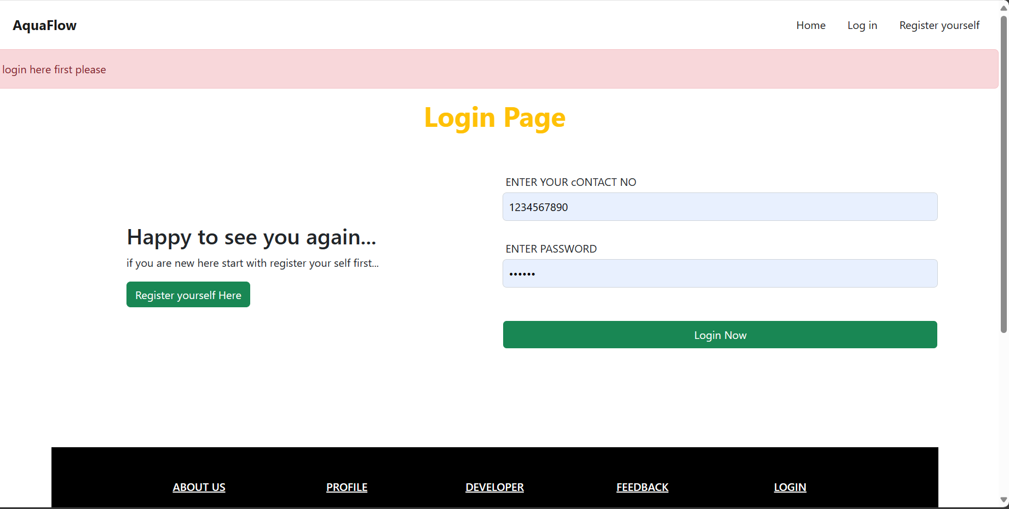
Snapshots:
Successful Testing

Slide 14
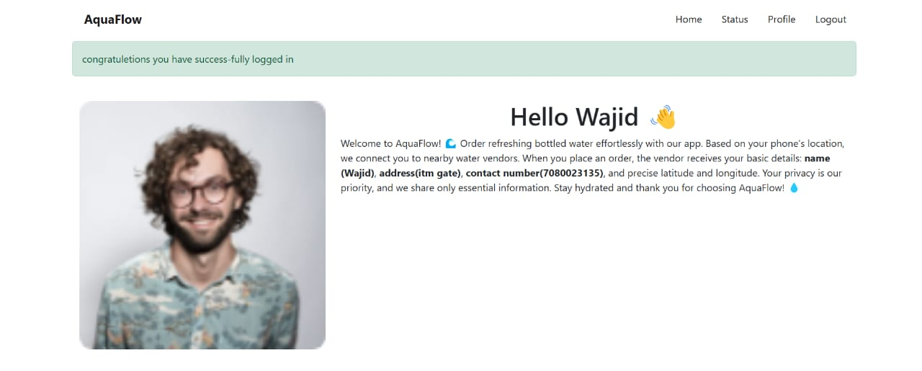
Snapshots:
Successful Testing
Successful Login Page

Slide 15
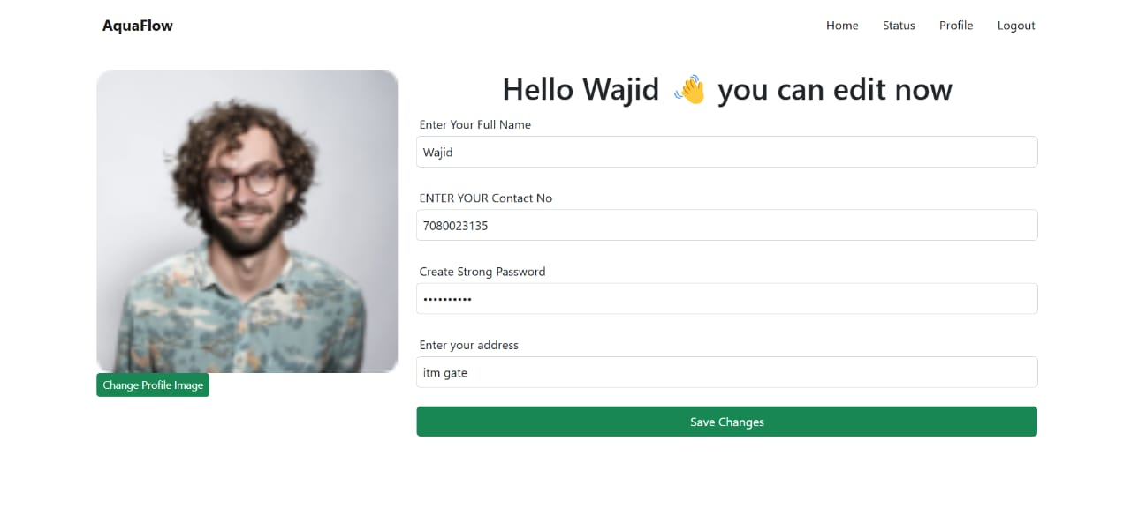
Snapshots:
Successful Testing
Profile Page

Slide 16
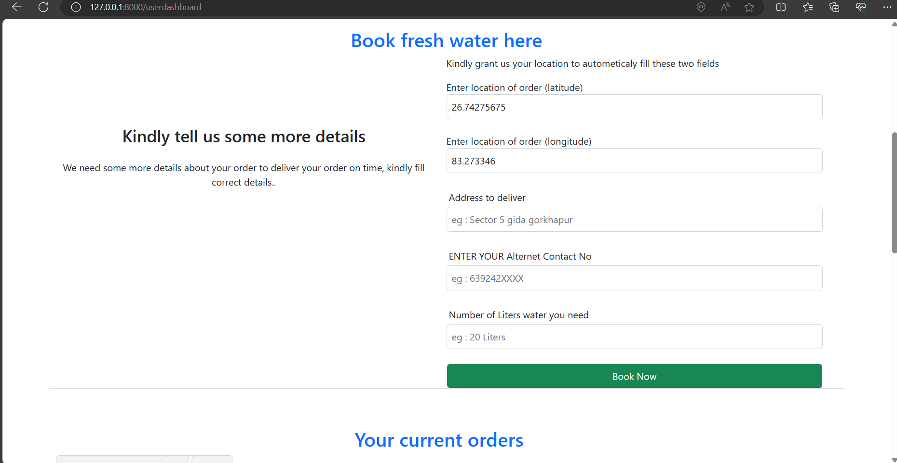
Snapshots:
Successful Testing
Order Page

Slide 17
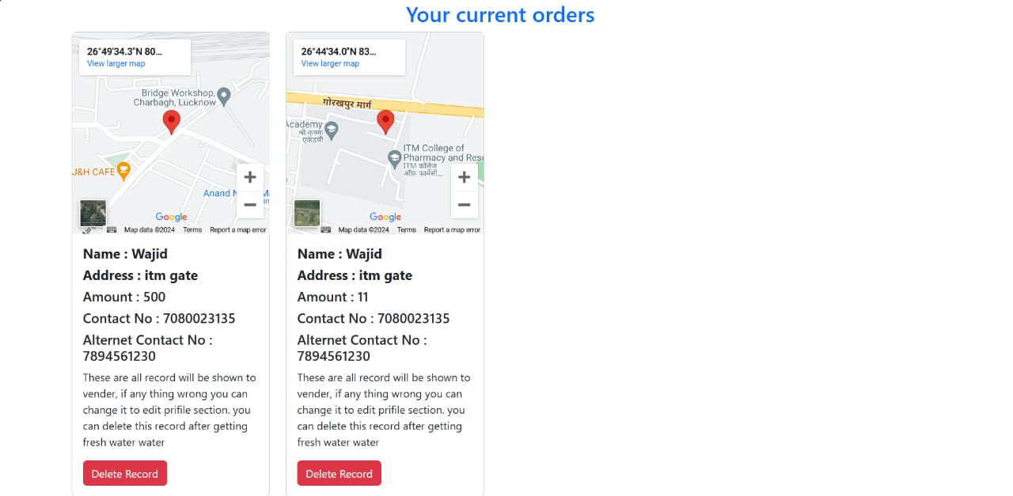
Snapshots:
Successful Testing
Delivery Location

Slide 18
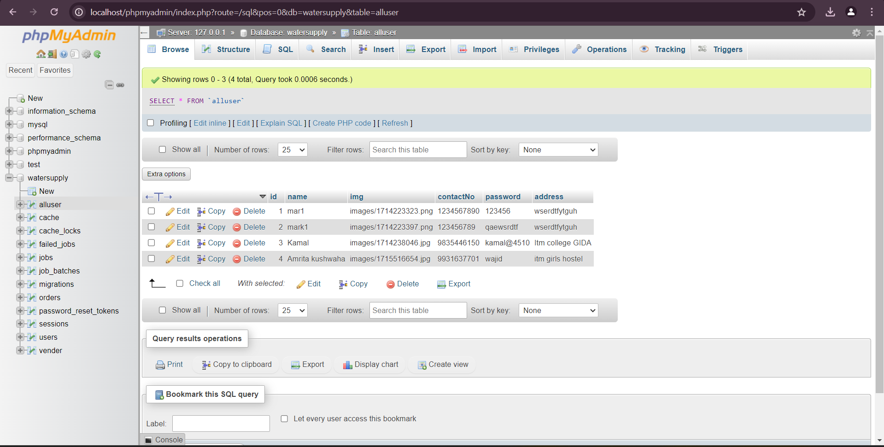
Snapshots:
Successful Testing
Customer Registration
details Database

Slide 19
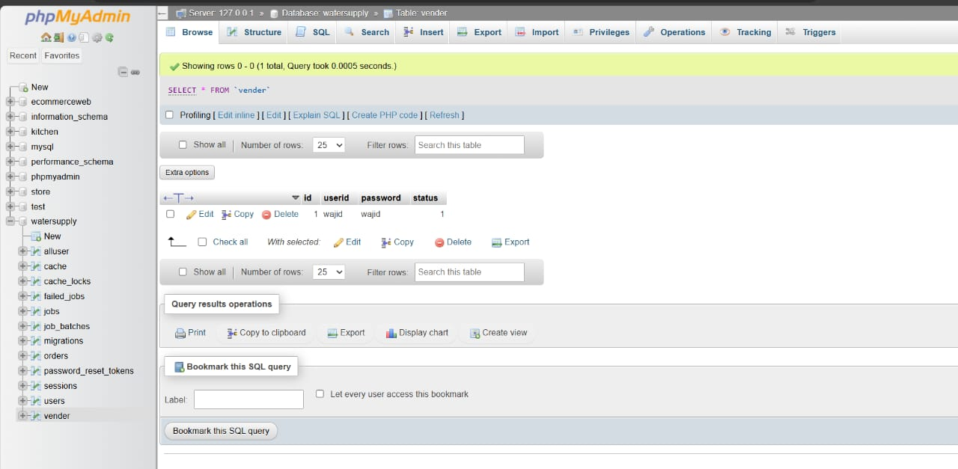
Snapshots:
Successful Testing
Vendor Details

Slide 20
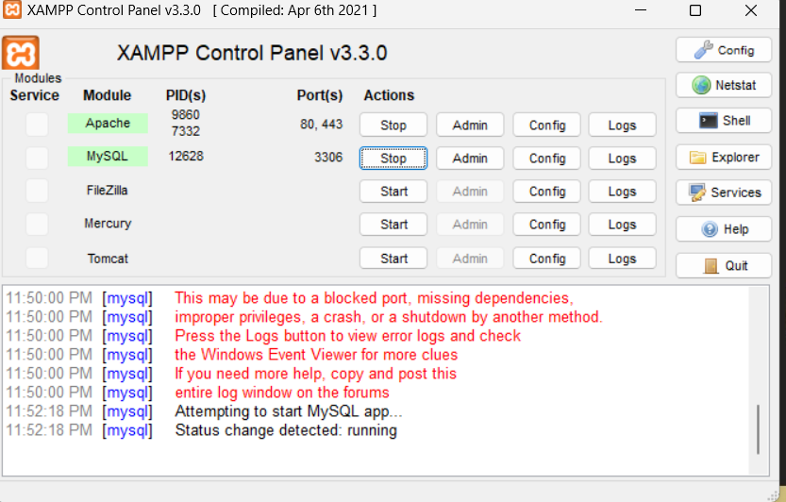
Snapshots:
Successful Testing
XAMPP Control Panel Open

Slide 21
8 Conclusion:
The integration of online ordering platforms has emerged as a transformative solution in addressing the challenges associated with the circulation of drinking water across India. This digital revolution has significantly enhanced accessibility, reliability, and efficiency in procuring safe drinking water, transcending traditional barriers and empowering consumers across the country.
Through the convergence of technology, commerce, and innovation, online ordering platforms have democratized access to safe drinking water, particularly in remote and underserved areas. By leveraging the ubiquity of smartphones and the reach of the internet, consumers can now effortlessly locate nearby suppliers, compare offerings, and place orders with unprecedented ease.
Furthermore, the utilization of geospatial intelligence, exemplified by platforms like Google Maps, has optimized logistical operations, streamlining delivery routes and reducing lead times. Real-time tracking features provide consumers with valuable insights into delivery timelines, enhancing transparency and trust in the process.
However, while online ordering platforms offer immense potential, challenges such as infrastructural gaps, digital literacy disparities, and regulatory complexities persist. Addressing these challenges will require concerted efforts from stakeholders across the public and private sectors, including government agencies, technology providers, and community organizations.
Moving forward, it is imperative to prioritize investments in infrastructure development, digital literacy initiatives, and regulatory frameworks to ensure the equitable and sustainable implementation of online ordering platforms for drinking water distribution. By fostering partnerships, incentivizing collaborations, and fostering a culture of innovation, stakeholders can unlock the full potential of technology in addressing water-related challenges and advancing the well-being of communities nationwide.

Slide 22


